Slide 1
Anti-fascism in the British and Irish Isles: National Variations in Opposition to the Far Right
Jeremy Tranmer
Université de Lorraine/IDEA

Slide 2
Introduction
Anti-fascism:
Since 1920s
Transnational phenomenon / national cultures
Many countries, including UK and Ireland
Mobilised tens of thousands in demonstrations, concerts, etc
Terminology:
- Opposition to forces to right of mainstream framed as anti-fascism
- Anti-racism / anti-fascism

Slide 3
Types of anti-fascism
- State: measures taken against far right
- Liberal: information, raising awareness, peaceful protest
- Militant: + physical force (‘no platform’)
Division between liberal and militant sometimes blurred, cooperation
Violence = stop far right public activities
prevent marches (occupying assembly point)
break up marches (attacking them)
prevent meetings (blocking entrance to venue)
disrupt meetings (infiltrating them)

Slide 4
Activists, ie those with sustained commitment
Small groups, not necessarily representative
Particular demographic: men, predominantly youngish
Neither condone nor condemn
Not examine success / failure
Not a history of anti-fascism, but background information needed

Slide 5
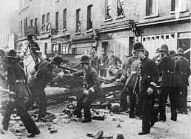
‘Battle of Cable Street’, 4 October 1936

Slide 6
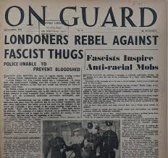
43 Group (1946)

Slide 7
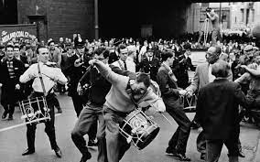
62 Group (1962)

Slide 8
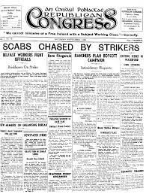
Republican Congress (1934)

Slide 9
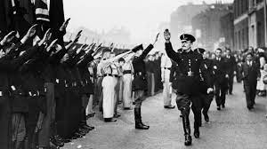
Oswald Mosley’s residence in Ireland burned down (1954)

Slide 10
Anti-fascism
BIRCHALL Sean, Beating The Fascists. The Untold Story of Anti-Fascist Action, London: Freedom Press, 2010.
COPSEY Nigel, Anti-Fascism in Britain, London: Palgrave, 2000.
HANN Dave and TILZEY Steve, No Retreat. The Secret War Between Britain’s Anti-Fascists and the Far Right, Lytham: Milo Books, 2003.
RENTON David, Never Again: Rock Against Racism and the Anti-Nazi League 1976-1982, Abingdon: Routledge, 2018.
TESTA M., “‘A Good Deal of Disorder’ or The Anarchists & Anti-Fascism in the UK”, Anarchist Studies, 25(2), 2017, 9-25.
ARLOW Jonathan, “Antifa without fascism: the reasons behind the anti-fascist movement in Ireland”, Irish Political Studies, Volume 35, 2020 – Issue 1, p. 115-137.
O’REILLY Bernardo, Undertones. Anti-fascism and the Far Right in Ireland 1945-2012, Dublin: AFA Ireland, 2012.

Slide 11
Transnational aspects of anti-fascism
BREKEN Kasper, COPSEY Nigel and FEATHERSTONE David, Anti-fascism in a Global Perspective, Abingdon: Routledge, 2021.
COPSEY Nigel, “Crossing Borders: Anti-Fascist Action (UK) and Transnational Anti-Fascist Militancy in the 1990s”, Contemporary European History, Vol. 25, Special Issue 4, November 2016, p. 707-727.
GORDON Daniel A., “French and British Anti-Racists Since the 1960s: A rendez-vous manqué?”, Journal of Contemporary History, Vol 50(3), July 2015, p. 603-661.
TESTA M., Militant Anti-Fascism. A Hundred Years of Resistance, London: PM Press, 2015.
TORRENT Mélanie, “Les circulations militantes entre Paris et Londres”, hommes et migrations, 1325, 2019, p. 35-45.
TRANMER Jeremy, “La droite radicale vue par ses oposants: l’anti-fascisme en Grande-Bretagne et en France”, in Philippe Vervaecke (ed), A droite de la droite. Droites radicales en France et Grande-Bretagne au Xxème siècle, Lille: Presses universitaires du Septentrion, 2012, p. 195-217.

Slide 12
1. Two main anti-fascist organisations since 1970s
Anti-Nazi League
Anti-Fascist Action
Basic relationship between organisations in Britain and Republic of Ireland?
2. Closer analysis of connections
Origins
Members
Activities

Slide 13
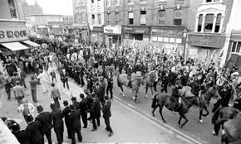
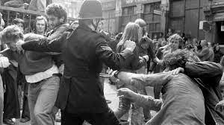
1. Two main anti-fascist organisations
Anti-Nazi League (ANL)
GB
‘Battle of Lewisham’ 1977
United front
Political / ideological opposition
Physical opposition
Disbanded in 1982

Slide 14
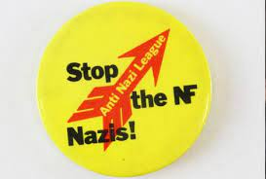
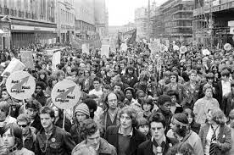
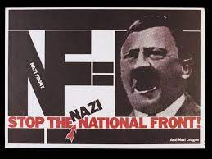
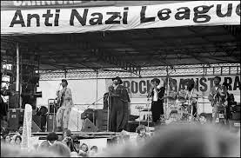
Pickets of NF meetings
Counter demos
Southall 1979
Death of Blair Peach
‘Squads’: self-defence
Informing
NF = Nazi
World War Two
Public meetings
Leaflets, pamphlets, posters
Rock Against Racism
Joint carnivals in 1978

Slide 15
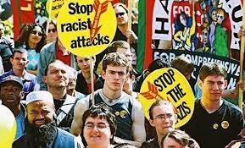
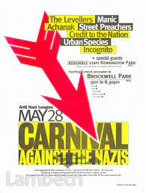
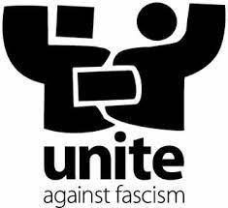
Reformed 1992
Reaction to increased support for BNP
Counter-demonstrations
Leaflets
Carnival
Merged into Unite Against Fascism 2004

Slide 16
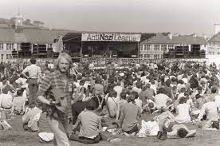
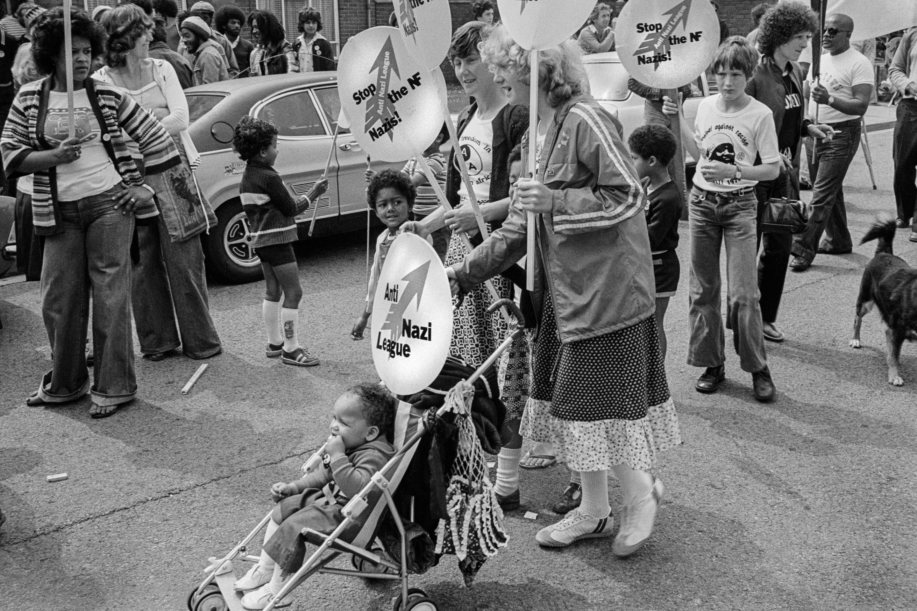
Scotland and Wales

Slide 17
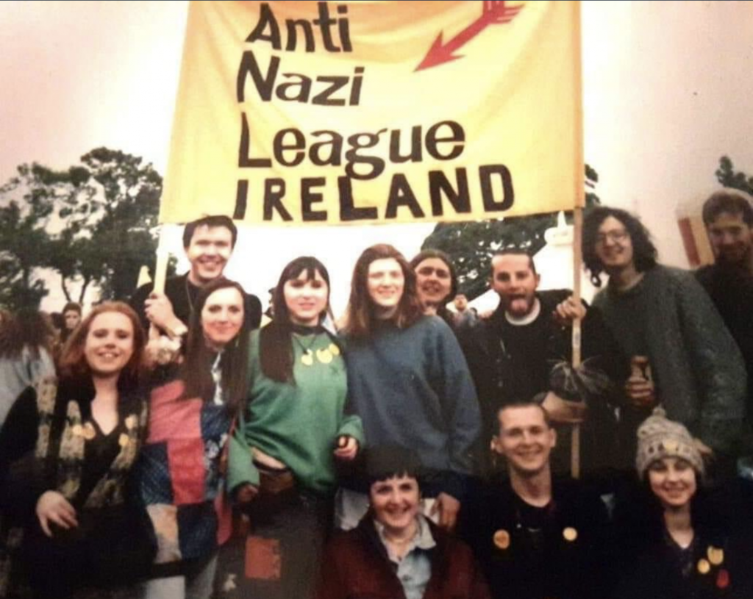
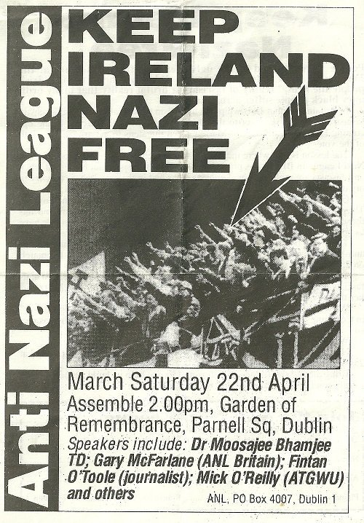
ANL Ireland

Slide 18
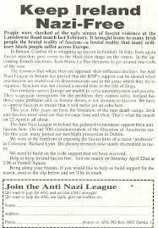
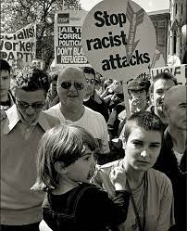

Slide 19
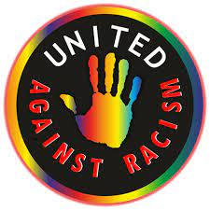
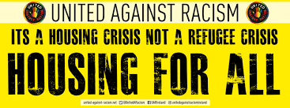
United Against Racism

Slide 20
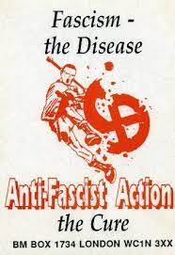
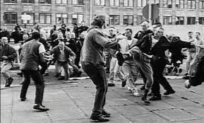
b) Anti-Fascist Action (AFA)
1985 – 2001
Members of ANL squads
Physical confrontation
Ideological confrontation
Protected meetings
Disrupt far right activities
Waterloo Station 1992

Slide 21
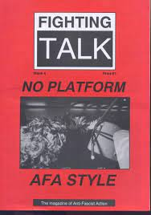
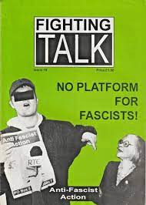
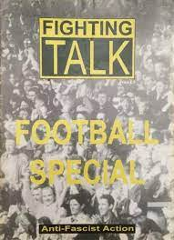
Magazine

Slide 22
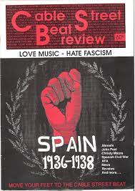
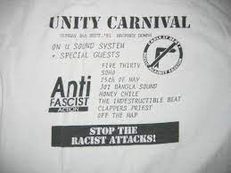
Music

Slide 23
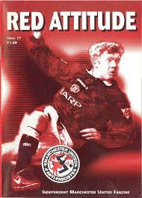
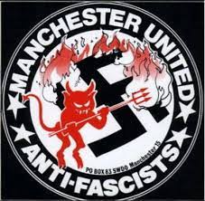
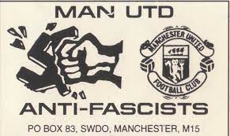
Football
Manchester United

Slide 24
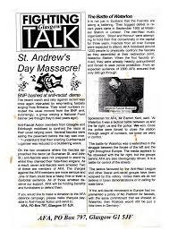
Scotland and Wales

Slide 25
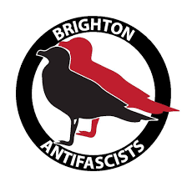
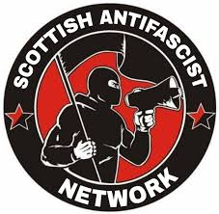
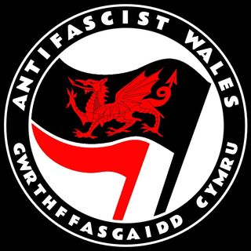
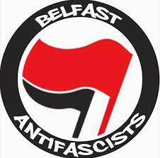
2012 Anti-Fascist Network

Slide 26
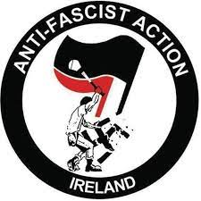
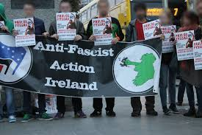
AFA Ireland
1991 –
Left-wing activists + Republicans
Twin-track approach
Clashes extreme anti-abortion grouping
Youth Defence
1996 immigrants + asylum seekers
1998 joint organisers of demo in Dublin
No Racism – No Deportations (1,000)
Mid-2010s PEDIGA

Slide 27
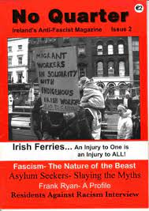
Magazine

Slide 28
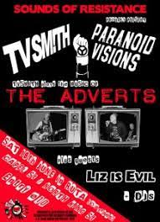
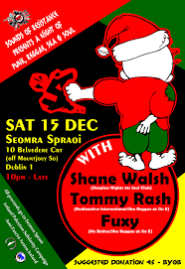
Music

Slide 29
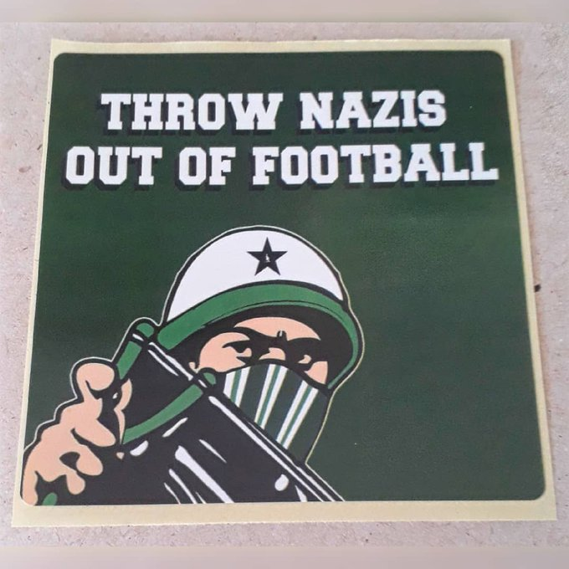
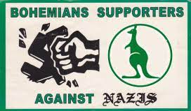
Football

Slide 30
ANL, AFA
Same names
Similar analyses of far right and opposition
Similar framing
Similar repertoires of contention
But
Different organisations

Slide 31
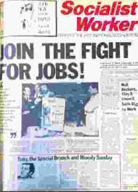
2. Origins and members
Far left
‘Battle of Cable Street’: CPGB
ANL
Created in GB by members of
Socialist Workers Party (SWP)
Trotskyist party
Forefront of anti-fascism

Slide 32
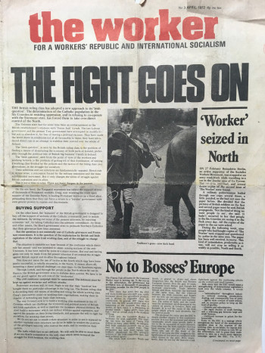
ANL Ireland
Founded by members of
Socialist Workers Movement (SWM)
Supporters of SWP based in Ireland

Slide 33
ANL: a British export to Ireland?
SWP + SWM = International Socialist Tendency
Independent, but like-minded organisations
Similar vision of anti-fascism
Conor Kostick + Brian Hanley:
Admiration / awe
International Socialist Tendency dominated by SWP
Follow lead
Dependency: The Worker printed in London

Slide 34
SWP/ANL model
Success in 1970s
1992 France
Pressure on SWM to adopt same approach in Ireland
Ties between Britain and Ireland
Hanley: impact of events in UK (eg miners’ strike)
Kostick: born in England, worked for SWP, Irish parent, moved to Ireland
Jerry Fitzpatrick (national organiser of ANL): Irish parents, member of London branch of Northern Ireland Civil Rights Association
Creation of ANL Ireland = result of combination of factors

Slide 35
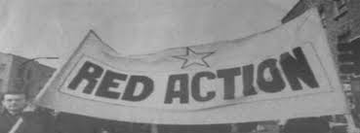
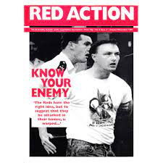
AFA
Created in GB by members of Red Action
Small far left party
Former members of ANL Squads
Heavily involved in anti-fascism

Slide 36
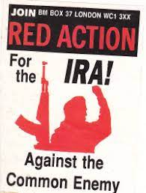
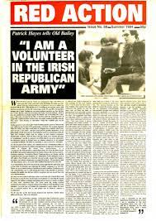
Interest in Irish issues
Anti-imperialism
Pro-Republican stance
Uncritical support for IRA, INLA
Contact with paramilitaries
Liam Heffernan 1993
(23 years for stealing explosives for the INLA)
Patrick Hayes and Jan Taylor 1994
(sentenced to 30 years in prison for IRA bombings)
“more Irish republican than British labour movement”

Slide 37
Personal dimension
Irish:
Gary O’Shea
Irish parents / grandparents:
Steve Tilzey
RA trips to Northern Ireland
AFA Ireland
Red Action
Irish workers: London, Dublin
Left-wing republicans
Political violence
Favourable opportunity structure?

Slide 38
Impact of AFA’s Irishness on its activities in Britain
Areas of strength: eg. Glasgow
Political enemy: Loyalists
Links with British far right
Hostile to Republicanism
Security at meetings about Northern Ireland
Support of sections of Glasgow Celtic fans and hooligans
Hostility of Glasgow Rangers fans

Slide 39
AFA
British organisation
But national differences
England / Scotland

Slide 40
AFA Ireland
Different issues
Specifically Irish imagery:
Starry plough
Easter lily

Slide 41
Shamrock
Tricolour

Slide 42
Imagery = difference between AFA GB and AFA I
AFA GB opposition to British nationalism
No British symbols
Paradoxically, difference linked to ideological similarity
Commitment to Irish republicanism
Solidarity with Northern Irish republicans
Aim of reunification of Ireland

Slide 43
Northern Ireland
ANL
- No organised presence of GB ANL, but small RAR group in Belfast
- RAR tours in 1979 (‘Rock Against Repression’) and 1980 (‘Rock The Block’)
- Concerts = non-sectarian and open to all
- But
- Held in nationalist/republican areas and pro-nationalist/republican themes
- Republican sympathies/hostility to loyalists + Jerry Fitzpatrick = Sinn Féin activist

Slide 44
AFA
AFA GB = no organised presence
AFA I = sent members to demonstrations

Slide 45
Today
Belfast Anti-Fascists: Anti-Fascist Network
Derry Anti-Fascist Action: AFA Ireland

Slide 46
Limited activities
Far right / Loyalist paramilitaries
- direct action = dangerous
Danger of cross-community conflict
if intervention in certain areas
Anti-fascism:
associated with supporters of united Ireland
tricolour anti-fascist flag at demonstration in Belfast

Slide 47
Conclusion
History of anti-fascism throughout British and Irish Isles
Organisations with same names
Created in GB, then Ireland
Not simply imitation: more complex phenomena at play
- transnational networks of activists
ideological affinity
immigration / personal connections between Ireland and Britain
circulation of ideas and experience
But behind similarities
differences in membership, alliances, opponents
not just between GB and Ireland, also within GB
due to political, social and cultural contexts and histories

